Slide 1
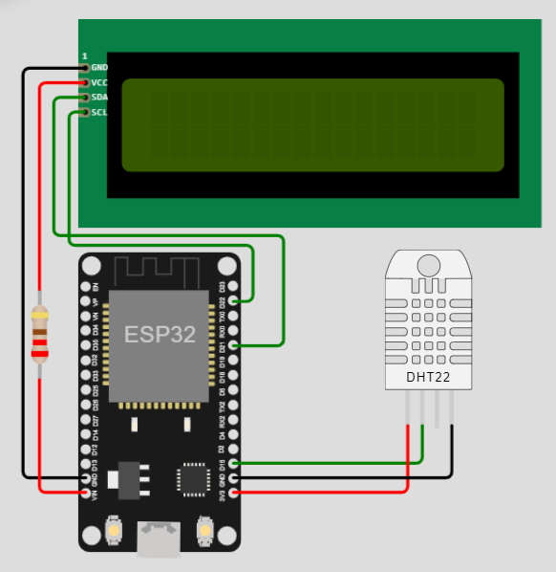
Mini Project (EEE3453)
Please view at slide show mode, (Animation/Transitions) enabled.
Construct an application using ESP32 micro-controller
to include the sensor reading of temperature OR humidity as input,
and display its value as output on an LCD display.
circuit
showcase

Slide 2
Application
Please view at slide show mode, (Animation/Transitions) enabled.
The sensor reading of temperature and humidity as input
Display its value as output on an LCD display
Can be used in
real-life application:
Humidity Control Box
Aircon control (Smart Home / Shopping Mall IOT)
circuit
showcase

Slide 3
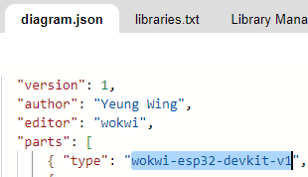
Please view at slide show mode, (Animation/Transitions) enabled.
Esp32-devkit-v1

Slide 4
Please view at slide show mode, (Animation/Transitions) enabled.
Module: LCD1602 I2C
An LCD with 2 lines, 16 characters per line
Connected to ESP 5V pin with 220Ω resistor, D21 D22 as data pin

Slide 5
Please view at slide show mode, (Animation/Transitions) enabled.
Module: DHT22
Digital Humidity and Temperature sensor
Connected to ESP 3V3 pin, D15 as data pin

Slide 6
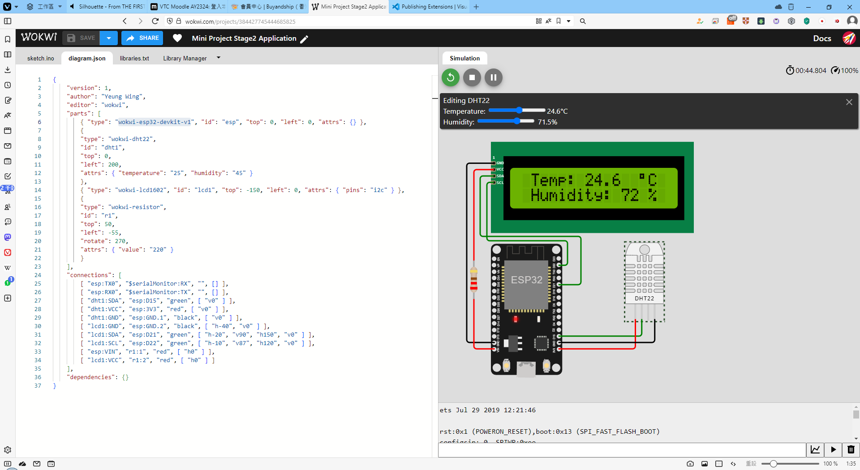
Please view at slide show mode, (Animation/Transitions) enabled.
Link:
Github: https://github.com/wingyeung0317/EEE3453/tree/master/Year1/Mini%20Project
Wokwi: https://wokwi.com/projects/384427745444685825

Slide 7
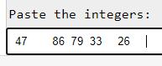
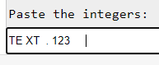
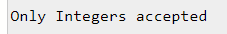
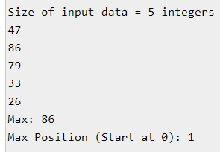

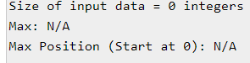
Program
Please view at slide show mode, (Animation/Transitions) enabled.
Define a new int array of 500 integers to store the input data.
Copy and paste a SINGLE column of integer data (assuming those are positive numbers with at most 3 digits) from the ‘Random integer data’ worksheet of the Excel file to the Serial Monitor. These integers are separated by spaces (ASCII code 3210).
Convert and store the input integers to the array.
Display the size of the input data.
Display the data nicely in the Serial Monitor, say, 20 integers on a row.
Stop capturing the data if the array is full.
Find out and display the maximum value and its position (0-indexed) of first occurrence within the input.
The program should be able to accept new input.
Link:
Github: https://github.com/wingyeung0317/EEE3453/tree/master/Year1/Mini%20Project
Wokwi: https://wokwi.com/projects/384446477466744833

Slide 8
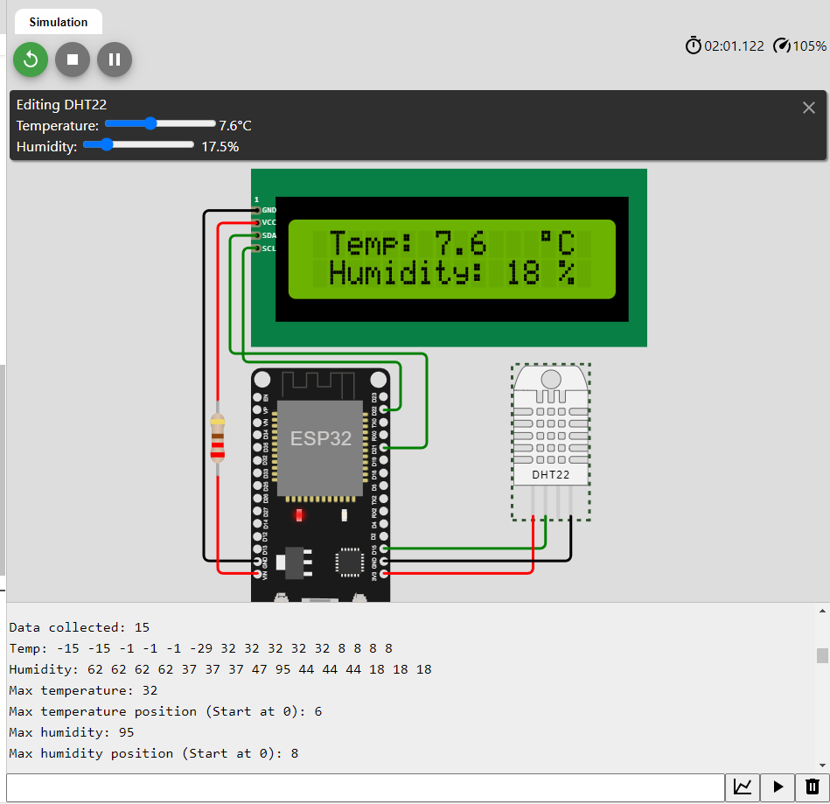
Please view at slide show mode, (Animation/Transitions) enabled.
Merge Program and Application
Define a new int array of 500 integers to store the data.
Convert and store the temperature and humidity data to the integers array.
Display the size of the input data.
Display the data nicely
Stop capturing the data if the array is full.
Find out and display the maximum value and its position (0-indexed) of first occurrence within the input.
Link:
Github: https://github.com/wingyeung0317/EEE3453/tree/master/Year1/Mini%20Project
Wokwi: https://wokwi.com/projects/384474872821133313

